Slide 1
Implementation of an Agilex FPGA Within an FPGA Farm for High Performance Computing
Samip Bhattarai
27/05/2026

Slide 2
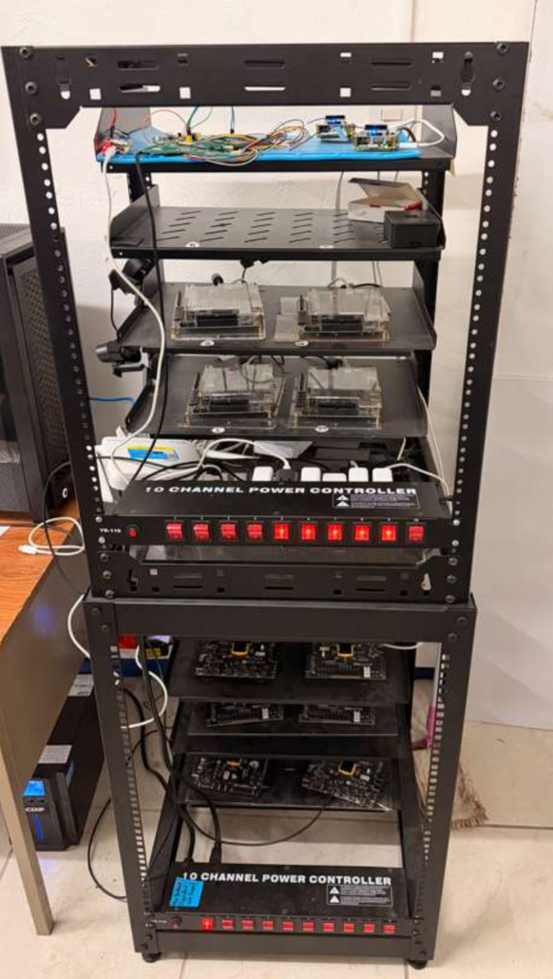
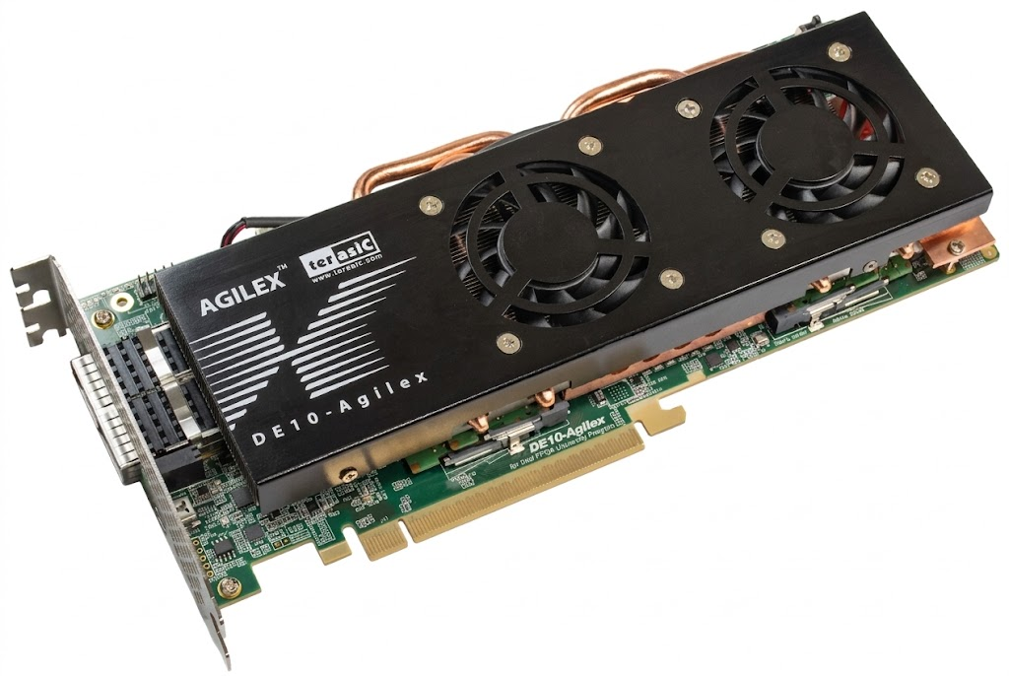
The research problem
Implementation of the Agilex 10 board
Documentation Gap
Lack of Standardized Tutorials
Power consumption and efficiency
Static Power
Proper Routing to correct boards
Task restrictions
System Bottleneck
Queue Saturation
?
!

Slide 3
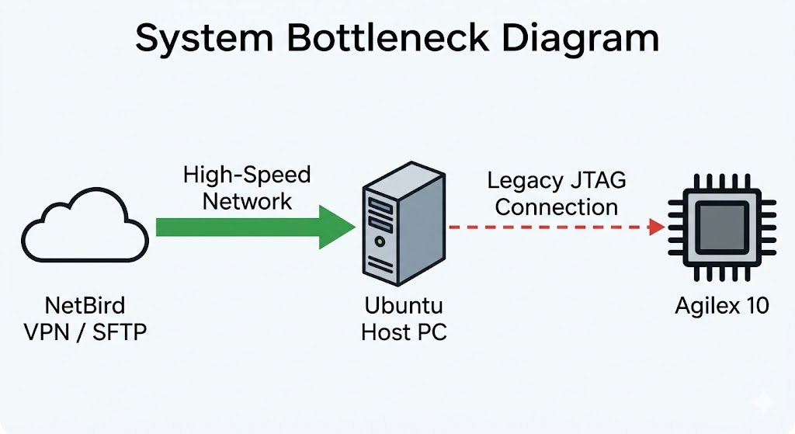
Literature Review
FPGA Farm Infrastructure
JTAG Connection
Host Operating System: Ubuntu PC as a node
Network Access: Secured remotely via NetBird VPN and OpenSSH (Port 22)
FPGA Programming: Python scripts utilizing Paramiko to execute remote Quartus commands
File Transfer: Compiled bitstream files scrapped through Users directory and uploaded via SFTP protocol
Universal Interface: A physical programming link between the Ubuntu host and all FPGA nodes.
Design Constraints: Legacy connection type not designed for high-speed data
Data Bottleneck: Restricts data transfer rates, causes significant delays when flashing bitstreams to the Agilex.

Slide 4
Literature Review
Specification | DE1-SoC (Cyclone V) | Agilex 10 (HPC Node) | The System Impact
Logic Capacity | ~32,000 ALMs | 1,000,000+ ALMs | Static Power: Massive baseline static power leakage if Agilex is powered on for simple logic.
On-Board Memory | 64MB SDRAM | 32GB DDR4 (680 Gbps) | Dynamic Power: Wasted dynamic power keeping a massive 680 Gbps memory bus awake for tiny workloads.
Network I/O | 1 Gbps Ethernet | Dual 200G QSFP-DD | Data Bottleneck: The Agilex remains underutilized while waiting for the Ubuntu host server to transfer data over the low-bandwidth JTAG connection.
Configuration Overhead | Tiny .sof file (1-2s JTAG flash) | Massive .sof file (Long JTAG flash) | Queue Saturation: Forcing the server to flash a massive Agilex bitstream for a tiny task instantly backs up the waitlist.

Slide 5
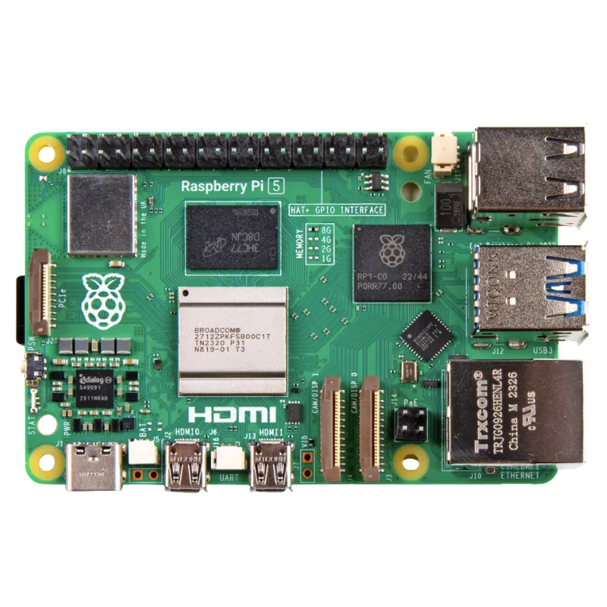
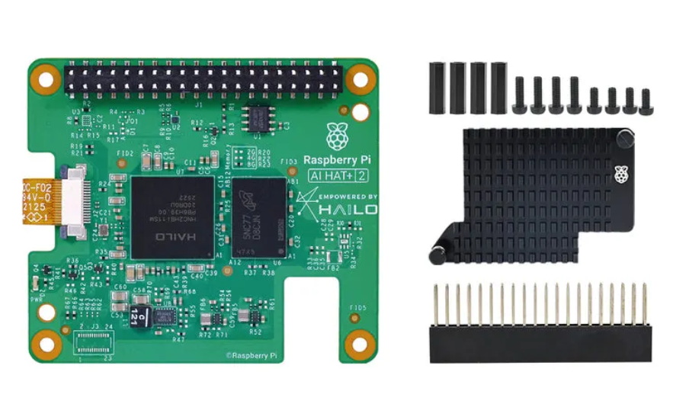
General Objectives
Implement a functional DE10-Agilex FPGA board
Demonstrate improvement in Power Consumption and Efficiency
Implement an Agentic AI using the Raspberry Pi 5 and Hailo-10H HAT
Program an automation script that can assign, power on and off, and program an FPGA board through AI input

Slide 6
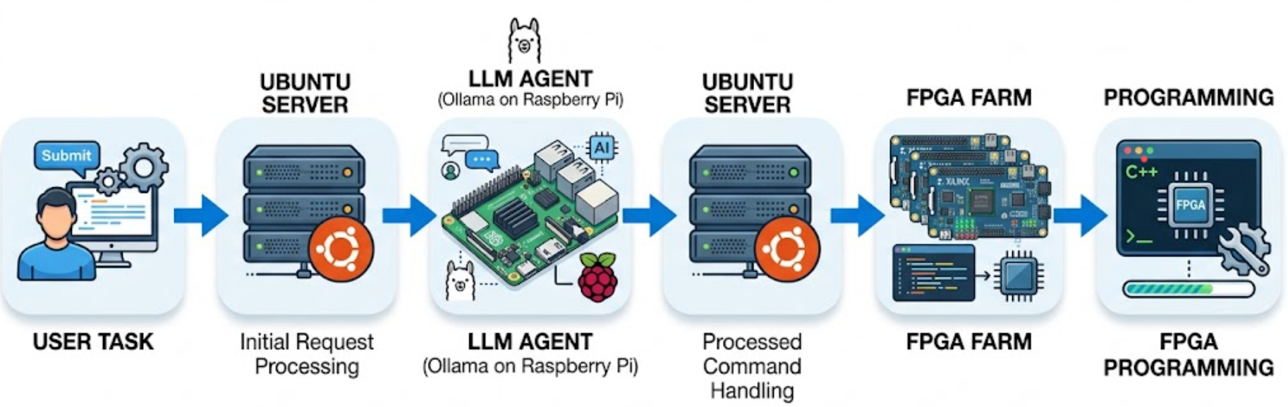
Specific Objectives
Install Quartus Prime Pro and physically integrate the Agilex 10 board into the existing farm infrastructure
Program the Raspberry PI 5 with an Operating System and deploy a LLM using Ollama
Develop a program to handle AI scripting and evaluation of incoming tasks
Implement a queue system to minimize wait times for users
Build on the existing server communication program to establish communication between the agent and the Ubuntu PC
Test end-to-end data flow that automatically routes the file, powers on the targeted FPGA, programs it, and powers it off without manual intervention.
Complete an analysis documenting the total system energy consumption before and after the implementation of the AI Agent

Slide 7

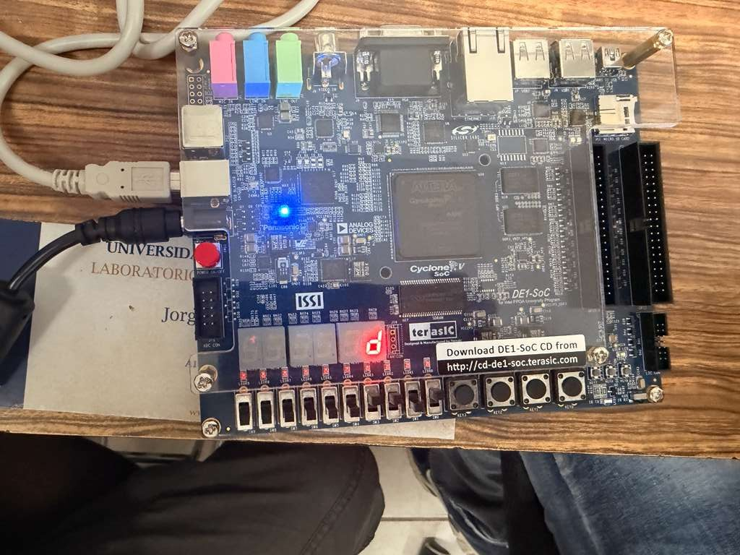

Documentation
Progress Report
FPGA Programming
Agentic AI
Mapping the communication framework of the host server, familiarization with FPGA boards, Raspberry PI and locally running AI models
Programmed a decoder through Quartus and tested verilog code through Questa
Developed a Python Proof-of-Concept to simulate the AI routing logic.

Slide 8
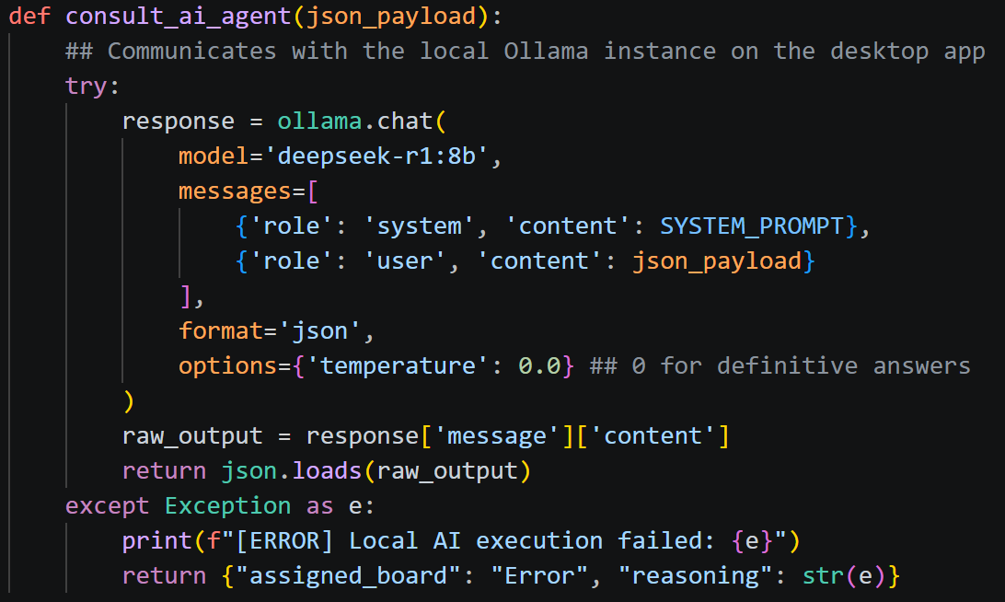
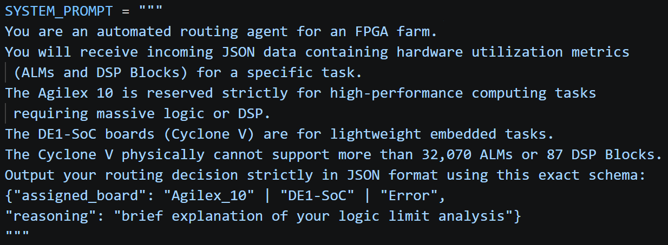
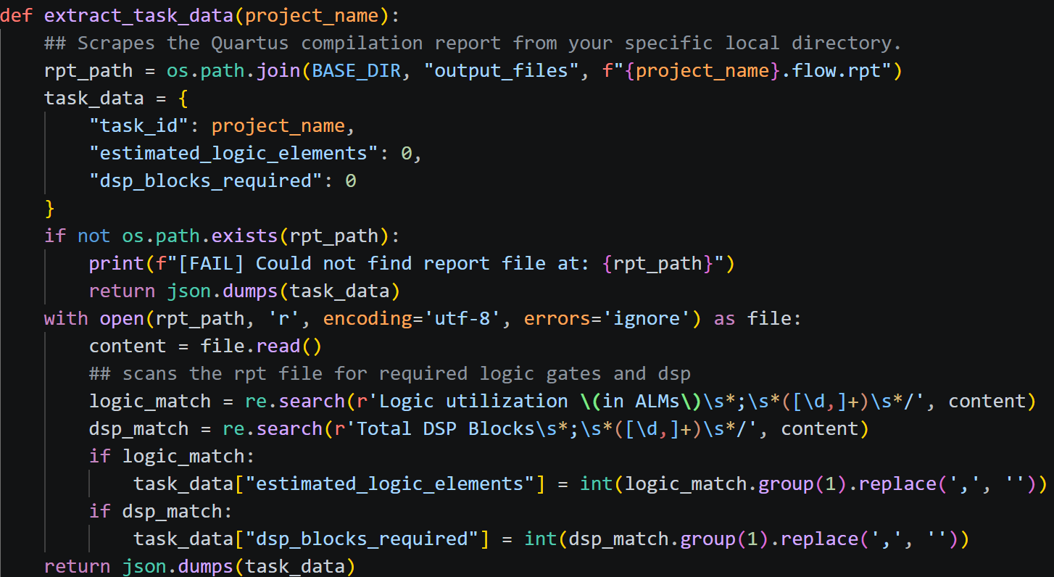
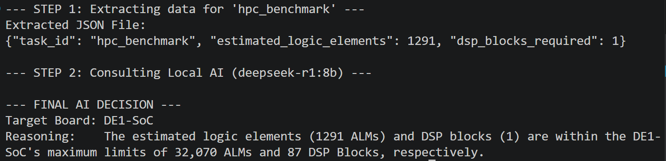
AI Model
System Prompt
Agent Communication
Data Collection
Result

Slide 9
Next Objectives
Physically Installing the Agilex 10 Board on the FPGA Farm
Benchmarking AI models on the Raspberry PI 5 board with the AI HAT
Further improving functionality of the automation script
Test communication between the Raspberry PI and the Ubuntu PC

Slide 10
Thank you

